Slide 1
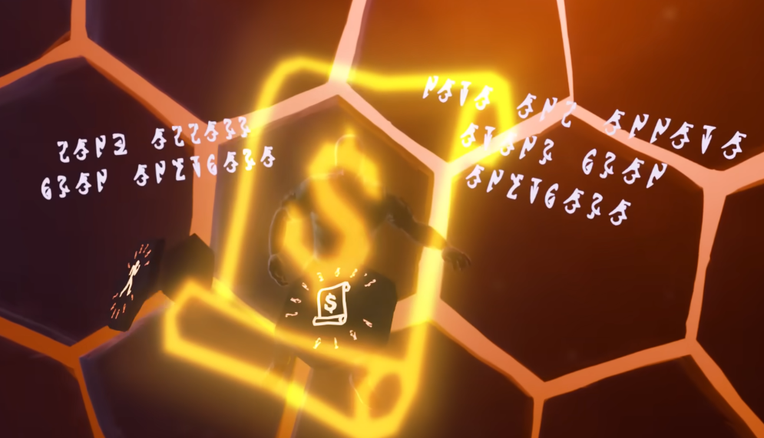
Bank access
from anywhere
Banker’s Note
Note and unnote
Items from
anywhere

Slide 2

Automatic
ultra compost
Chance to give
extra yield
and save
planted seeds
Produce
is noted
Farming frenzy
Seeds planted automatically grow to full
Plant max
herbs using
a single
seed

Slide 3
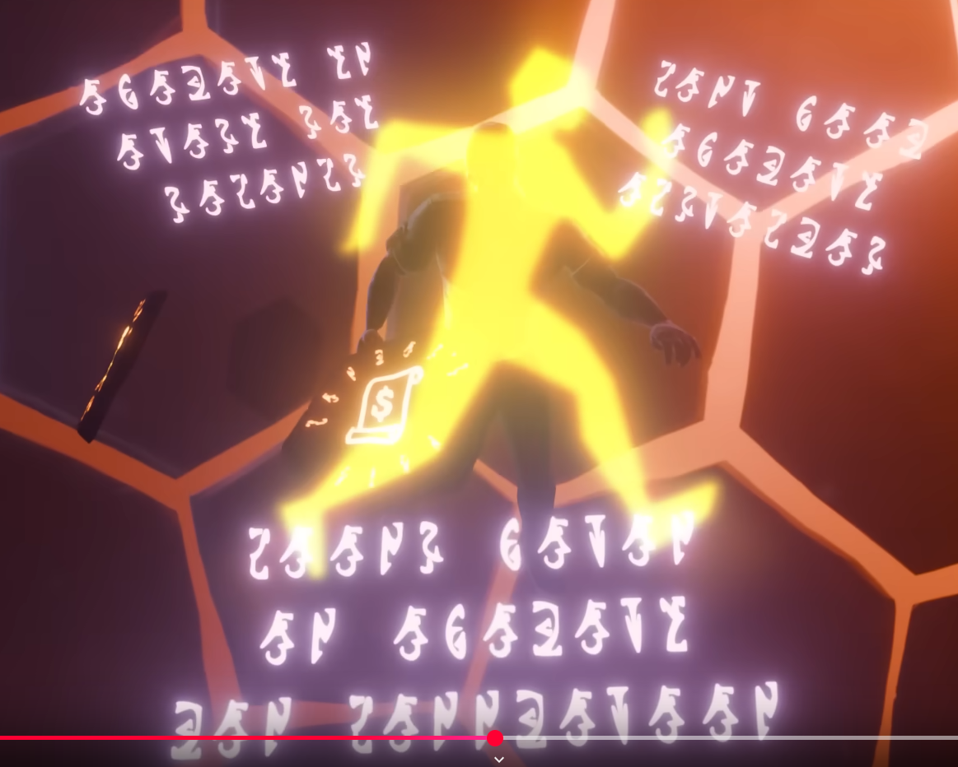
Agility xp
every six
seconds
Golden footed
Dont fail
agility
obstacles
Coins given
on agility
lap completion

